Slide 1
Unit 5 Sequential Logic Circuits

Slide 2
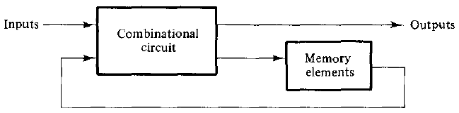
Sequential Logic Circuits
Memory elements are devices capable of storing binary information within them.
The binary information stored in the memory elements at any given time defines the state of the sequential circuit.
Block diagram shows external outputs in a sequential circuit are a function not only of external inputs, but also of the present state of the memory elements.
Thus, a sequential circuit is specified by a time sequence of inputs, outputs, and internal states.

Slide 3
Flip-Flops
The memory elements used in clocked sequential circuits are called flip-flops. These circuits are binary cells capable of storing one bit of information.
A flip-flop circuit has two outputs, one for the normal value and one for the complement value of the bit stored in it.
Binary information can enter a flip-flop in a variety of ways, a fact that gives rise to different types of flip-flops.
Since a flip flop can store one of the value i.e either normal or complemented value, it is called as bistable circuits.
Latch:
A flip flop with no control pulse or clocked signal is known as latch.

Slide 4
Basic flip-flop circuit (direct-coupled RS flip-flop or SR latch)
A flip-flop circuit can be constructed from two NAND gates or two NOR gates.
These constructions are shown in the logic diagrams below. Each circuit forms a basic flip-flop upon which other more complicated types can be built.
The cross-coupled connection from the output of one gate to the input of the other gate constitutes a feedback path.
For this reason, the circuits are classified as asynchronous sequential circuits. Each flip-flop has two outputs, Q and Q', and two inputs, set and reset.

Slide 5
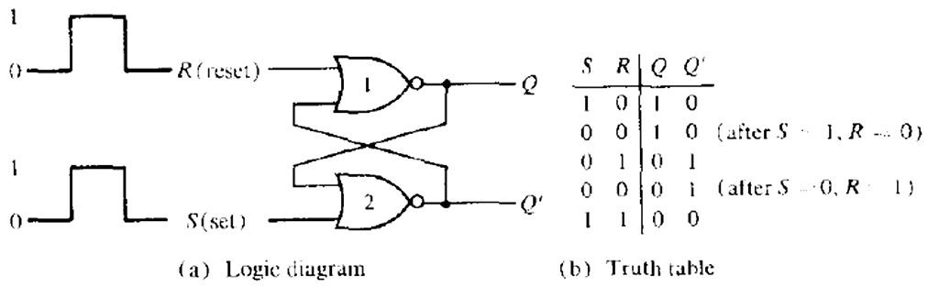
Fig: basic flip-flop circuit with NOR gates

Slide 6
First, assume that the set input is 1 and the reset input is 0. Since gate-2 has an input of 1, its output Q' must be 0, which puts both inputs of gate-1 at 0, so that output Q is 1. When the set input is returned to 0, the outputs remain the same i.e. output Q' stay at 0, which leaves both inputs of gate-1 at 0, so that output Q is 1.
Similarly, 1 in the reset input changes output Q to 0 and Q' to 1. When the reset input returns to 0, the outputs do not change.
When a 1 is applied to both the set and the reset inputs, both Q and Q' outputs go to 0. This condition violates the fact that outputs Q and Q' are the complements of each other. In normal operation, this condition must be avoided by making sure that 1's are not applied to both inputs simultaneously.

Slide 7
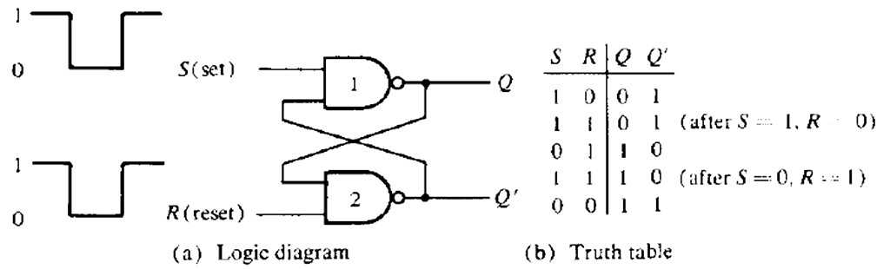
A flip-flop has two useful states.
Set state: When Q = 1 and Q' = 0, (or 1-state),
Reset state: When Q = 0 and Q' = 1, (or 0-state)
The outputs Q and Q' are complements of each other and are referred to as the normal and complement outputs, respectively. The binary state of
Fig: Basic flip-flop circuit with NAND gates

Slide 8
The operation of the basic flip-flop can be modified by providing an additional control input that determines when the state of the circuit is to be changed. This fact arises 4 common types of flip-flops and are discussed in what follows:
RS Flip-Flop
It consists of a basic flip-flop circuit and two additional NAND gates along with clock pulse (CP) input. The pulse input acts as an enable signal for the other two inputs.
When the pulse input goes to 1, information from the S or R input is allowed to reach the output.
Set state: S = 1, R = 0, and CP = 1.
Reset state: S = 0, R = 1, and CP = 1.
In either case, when CP returns to 0, the circuit remains in its previous state. When CP = 1 and both the S and R inputs are equal to 0, the state of the circuit does not change

Slide 9
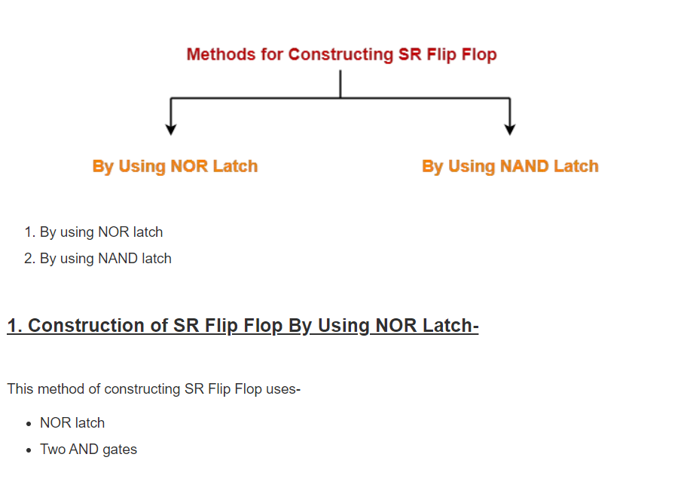
Construction of SR Flip-Flip

Slide 10
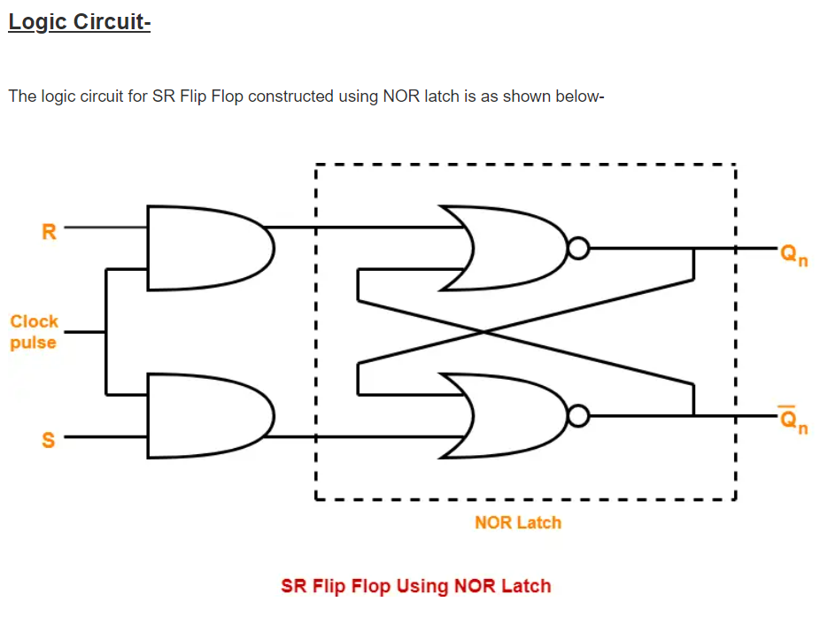
Logic Circuit:

Slide 11
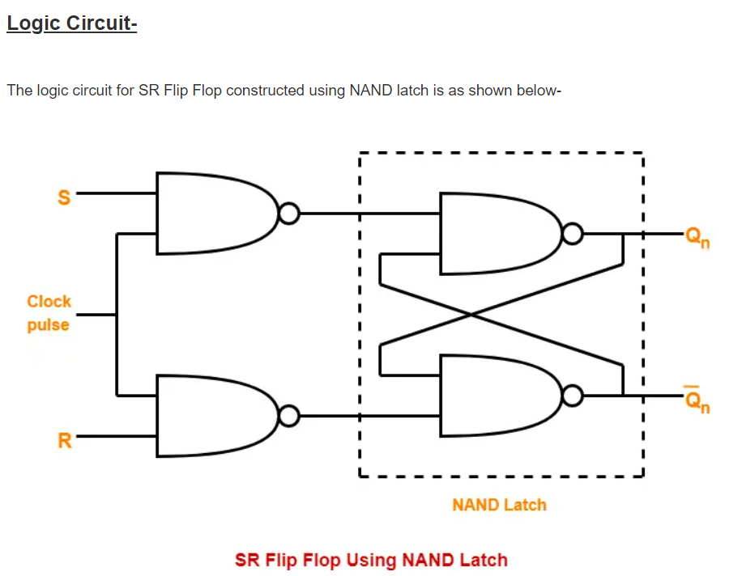
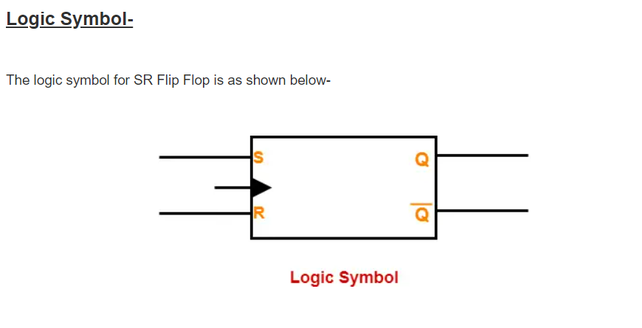

Slide 12
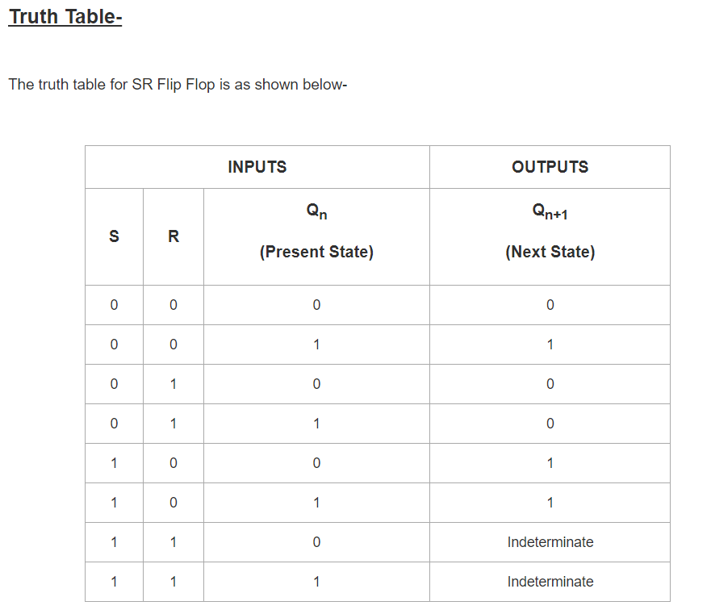

Slide 13
2. JK Flip Flop
A JK flip flop is a refinement of RS flip flop in that the indeterminate state of RS type is defined in JK type.
Inputs J and K behave like inputs S and R to set or clear the flip-flop respectively.
The input marked J is for set. When both inputs J and K are equal to1,the flip flop switches to its complements state, that is if Q=1, it switches to Q=o, and vice versa.
A JK flip flop constructed with two cross coupled NOR gates and two AND gates as shown in figure.

Slide 14
Working:
As shown in the figure, input is provided to the flip flop from J and K inputs.
The data value is stored in the flip flop when clock pulse (CP)=1.
When inputs from J=0 and K=0 then next state consist of previously stored memory value.
Similarly when J=1 and K=1 then the next state value is toggled i.e when Q=0 the Qt+1=1 and Vice-versa.

Slide 15
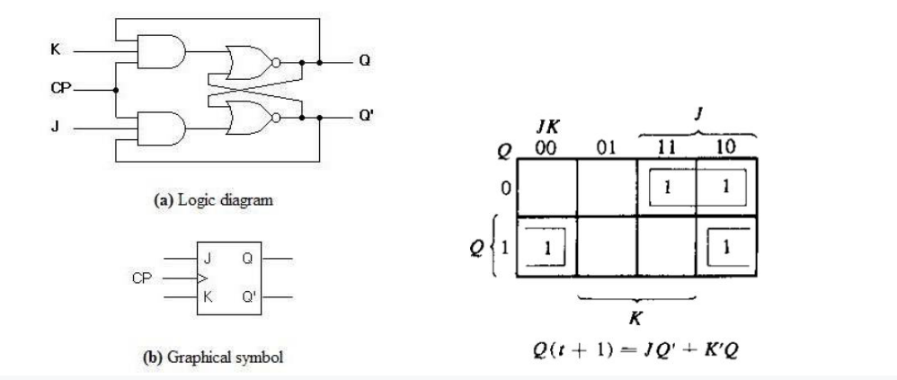

Slide 16
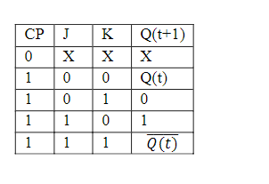
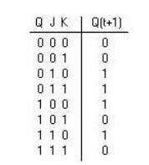
Fig: Functional Table Fig: Excitation Table

Slide 17
D Flip Flop
One way to eliminate the undesirable condition of the indeterminate state in the RS flip-flop is to ensure that inputs S and R are never equal to 1 at the same time.
This is done in the D flip-flop shown in Fig. below.
The D flip-flop has only two inputs: D and CP.
The D input goes directly to the S input and its complement is applied to the R input.
As long as CP is 0, the outputs of gates 3 and 4 are at the 1 level and the circuit cannot change state regardless of the value of D.
The D input is sampled when CP = 1.
If D is 1, the Q output goes to 1, placing the circuit in the set state.
If D is 0, output Q goes to 0 and the circuit switches to the clear state.

Slide 18
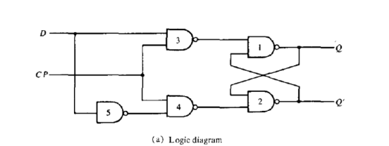
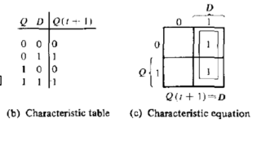

Slide 19
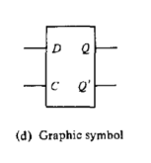

Slide 20
4. T Flip Flop
In T flip flop, "T" defines the term "Toggle".
We can construct the "T Flip Flop" by making changes in the "JK Flip Flop".
The "T Flip Flop" has only one input, which is constructed by connecting the input of JK flip flop
This single input is called T. In simple words, we can construct the "T Flip Flop" by converting a "JK Flip Flop".
Sometimes the "T Flip Flop" is referred to as single input "JK Flip Flop".
Block diagram of the "T-Flip Flop" is given where T defines the "Toggle input", and CLK defines the clock signal input.

Slide 21
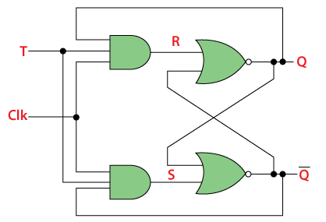
Construction:
The "T Flip Flop" is designed by passing the AND gate's output as input to the NOR gate of the "SR Flip Flop".
The inputs of the "AND" gates, the present output state Q, and its complement Q' are sent back to each AND gate. The toggle input is passed to the AND gates as input.
These gates are connected to the Clock (CLK) signal.
In the "T Flip Flop", a pulse train of narrow triggers are passed as the toggle input, which changes the flip flop's output state. The circuit diagram of the "T Flip Flop" using "SR Flip Flop" is given below:

Slide 22
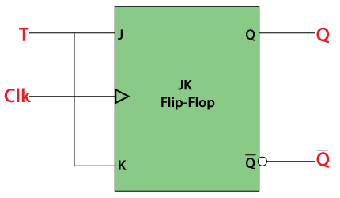

Figure: Functional Table
Figure: Graphical Symbol

Slide 23
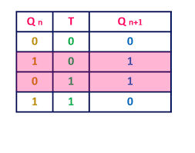
Functional Table:
Characteristic Equation: Yourself

Slide 24
Master-Slave JK Flip Flop
In "JK Flip Flop", when both the inputs and CLK set to 1 for a long time, then Q output toggle until the CLK is 1.
Thus, the uncertain or unreliable output produces.
This problem is referred to as a race-round condition in JK flip-flop and avoided by ensuring that the CLK set to 1 only for a very short time.

Slide 25
Operation of Master Slave Flip Flop:
The master-slave flip flop is constructed by combining two JK flip flops. These flip flops are connected in a series configuration.
In these two flip flops, the 1st flip flop work as "master", called the master flip flop, and the 2nd work as a "slave", called slave flip flop.
The master-slave flip flop is designed in such a way that the output of the "master" flip flop is passed to both the inputs of the "slave" flip flop.
The output of the "slave" flip flop is passed to inputs of the master flip flop.
In "master-slave flip flop", apart from these two flip flops, an inverter or NOT gate is also used.
For passing the inverted clock pulse to the "slave" flip flop, the inverter is connected to the clock's pulse.
In simple words, when CP set to false for "master", then CP is set to true for "slave", and when CP set to true for "master", then CP is set to false for "slave".

Slide 26
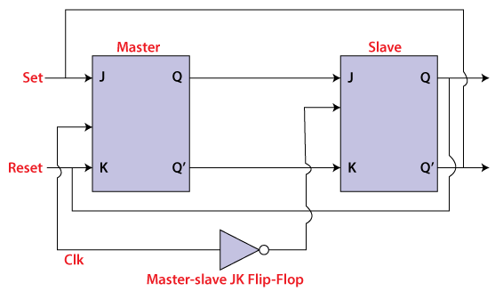

Slide 27
Working:
When the clock pulse is true, the slave flip flop will be in the isolated state, and the system's state may be affected by the J and K inputs.
The "slave" remains isolated until the CP is 1. When the CP set to 0, the master flip-flop passes the information to the slave flip flop to obtain the output.
The master flip flop responds first from the slave because the master flip flop is the positive level trigger, and the slave flip flop is the negative level trigger.
The output Q'=1 of the master flip flop is passed to the slave flip flop as an input K when the input J set to 0 and K set to 1.
The clock forces the slave flip flop to work as reset, and then the slave copies the master flip flop.
When J=1, and K=0, the output Q=1 is passed to the J input of the slave. The clock's negative transition sets the slave and copies the master.
The master flip flop toggles on the clock's positive transition when the inputs J and K set to 1. At that time, the slave flip flop toggles on the clock's negative transition.
The flip flop will be disabled, and Q remains unchanged when both the inputs of the JK flip flop set to 0.

Slide 28
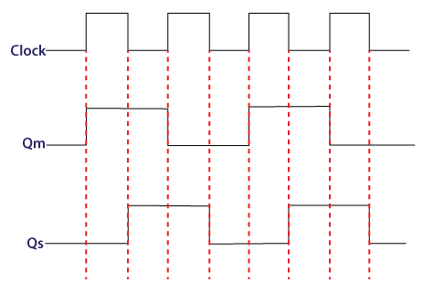
Timing Diagram:

Slide 29
Types of Sequential Circuits
There are two types of sequential circuits:
Synchronous sequential circuit
Asynchronous sequential circuit
Synchronous sequential circuit
A sequential circuit whose output behavior depends on the input at a discrete-time is called synchronous sequential circuits.
Synchronous sequential circuits that use clock pulses in the inputs of memory elements are called Clocked Sequential logic circuits

Slide 30
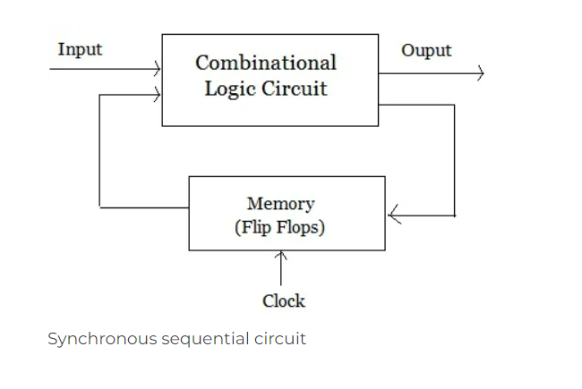

Slide 31
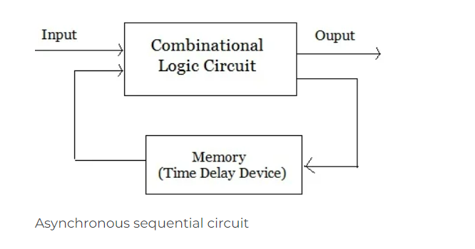
Asynchronous sequential circuit
The sequential circuit whose output depends on the sequence in which the input changes are called asynchronous sequential circuits.

Slide 32
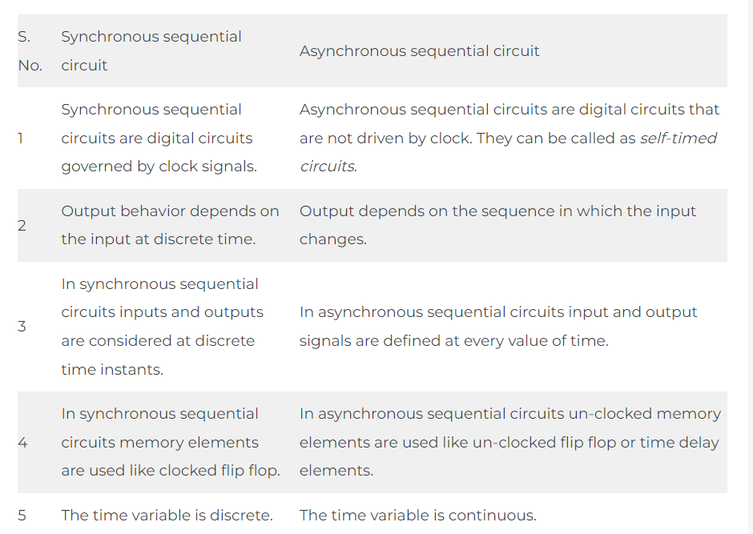
Differences Between Synchronous and Asynchronous Sequential Circuits

Slide 33
Edge Triggering and Level Triggering
Digital circuits employ edge triggering and level triggering as two different types of triggering methods to start a signal transition from one state to another.
Both are essential components of digital electronics and are used to speed up data flow and regulate the timing of events in the system.

Slide 34
Edge Triggering:
An example of a triggering mechanism that is based on the recognition of a change in the signal level is edge triggering.
It is employed whenever it is important to identify the change in the input signal’s condition from low to high or high to low.
Edge triggering is frequently employed in synchronous circuits, such as flip-flops and counters, and is especially beneficial in situations when exact timing is necessary.

Slide 35
Level Triggering:
On the other hand, level triggering is a category of triggering mechanism that is based on the detection of a particular signal level.
It is applied when detecting the input signal level at a specific moment rather than a change in state is required.
In applications like data acquisition and control systems, where continuous monitoring of an input signal is necessary, level triggering is frequently utilized.

